Slide 1
Course Name : Data Structures & Algorithms
Dr. S. Nandagopalan
Computer Science & Information Systems

Slide 2
Session 12: Topological Sort, Bi-connected Graphs, etc.

Slide 3
Contents
Topological Sort
Depth First Search with Time stamping
Biconnected and Auxillary graphs
Summary

Slide 4
Topological Sorting
Suppose you have a list of tasks to do, some of which depend on others to be completed first.
Example
A practical work may involve 6 tasks numbered 1 to 6. Tasks 3 and 4 must be carried out only after task 1. Task 3 must be completed before task4. Task 6 can be done only after all the rest have been completed
We can arrange this information in a dependency graph.
A DAG
3
1
4
6
2
5

Slide 5
Example
Definition: Let G = (V, E) be a directed graph. A topological order of G is a total order of vertex set V such that for all edges (v, w) ∈ E we have v → w.
A directed graph that does not have a cycle is called a directed acyclic graph (DAG)
pants
socks
3
1
4
6
belt
shoe
2
5
1 → 2 → 5 → 3 → 4 → 6
C
DS
ADA
1 → 2 → 3 → 4 → 5 → 6
1 → 2 → 4 → 3 → 5 → 6
C++
2 → 5 → 1 → 3 → 4 → 6

Slide 6
Topological order using DFS
Execute the DFS algorithm and keep track of the stack popping-up order of vertices
Reverse this order
Output this as topological ordering of the given dag

Slide 7
Example
3
3
3
1
1
1
4
6
4
6
4
6
2
2
2
5
5
1
5
(a)
(b)
(c)
3
1
3
4
6
4
2
Stack popping-up order:
6→4→3→1→5→2
5
(d)
3
6
1
2
Topological order:
2→5→1→3→4→6
4
6
5
2
(e)
5

Slide 8
Method-2: Algorithm
Let G be a graph. Recall that during an execution of DFS_Visit_All , the subroutine dfs is invoked exactly once for each vertex v.
Let us call vertex v finished after dfs is completed. During the execution of DFS_Visit_All, a vertex can be in three states:
not yet visited (let us call a vertex in this state white)
visited, but not yet finished (grey)
finished (black)

Slide 9
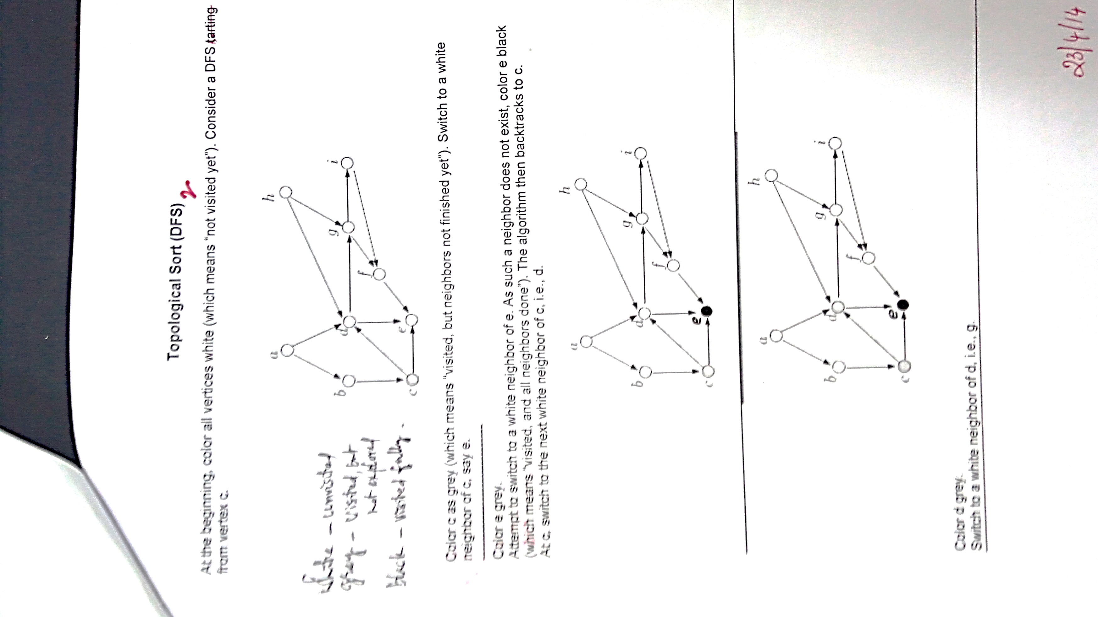
a
h
g
i
b
d
f
e
c
e, f, i, g, d, c, b, a, h

Slide 10
DFS with Timestamp
a
1/8
3/6
e
b
2/7
4/5
f
d(v) – ‘discovery’ time
F(v) – ‘finish’ time

Slide 11
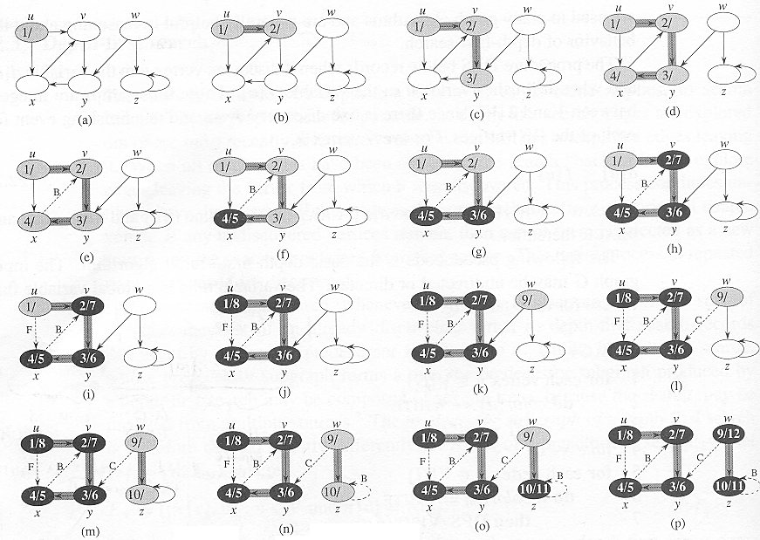
Example-2

Slide 12
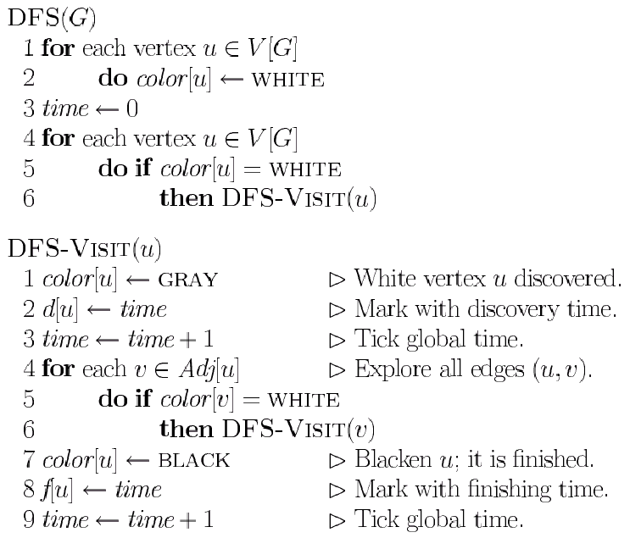
DFS Algorithm with Timestamp

Slide 13
Topological order using Source Removal
This method is based on removing a vertex which does not have incoming edges (zero in-degree) – called as source vertex.
Once we remove this vertex, all its outgoing edges must also be removed.
During every stage (iteration), identify such a source vertex and iterate until all vertices are covered.
The sequence generated by this removal process will form the topological ordering.

Slide 14
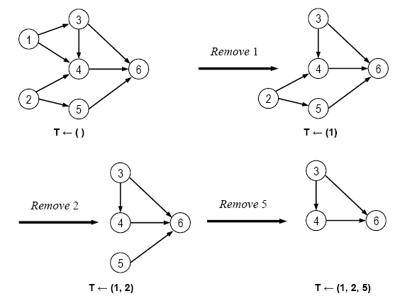
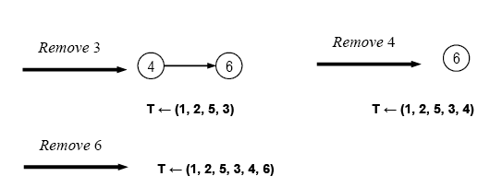
Example

Slide 15
Algorithm
■ Algorithm TopologicalSort(G)
// Input: Graph G = (V, E) with n vertices.
// Output: Topological ordering
T ← ø // Initialize the set, currently no vertices added
Let u be the staring vertex.
while true do
When u is not in T, select v that has no incoming edge (u, v)
if no such v break
T ← T + (u, v) // add the edge to the Topological ordering.
if |T| ≠ n return -1 // No topological ordering possible.
else return T
end TopologicalSort.

Slide 16
Separation Edges and Vertices
Definitions: Let G be a connected graph
A separation edge of G is an edge whose removal disconnects G
A separation vertex of G is a vertex whose removal disconnects G
Applications
Separation edges and vertices represent single points of failure in a network and are critical to the operation of the network
Example
DFW, LGA and LAX are separation vertices
(DFW,LAX) is a separation edge
ORD
PVD
SFO
LGA
HNL
LAX
DFW
MIA

Slide 17
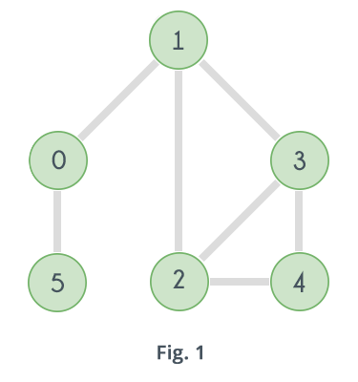
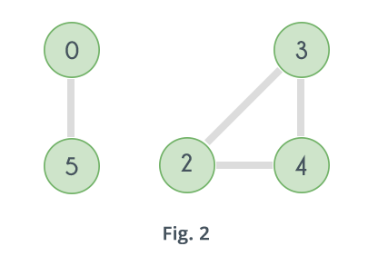
Articulation Points
In a graph, a vertex is called an articulation point if removing it and all the edges associated with it results in the increase of the number of connected components in the graph.
Remove vertex 1
Remove vertex 0

Slide 18
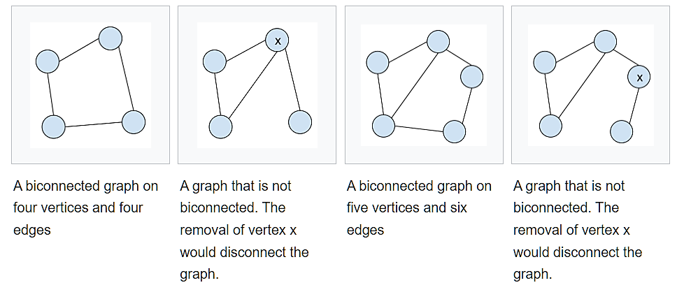
Biconnected Graph
A biconnected undirected graph is a connected graph that is not broken into disconnected pieces by deleting any single vertex (and its incident edges).
A biconnected directed graph is one such that for any two vertices v and w there are two directed paths from v to w which have no vertices in common other than v and w.
A graph with no articulation point called biconnected.

Slide 19
Biconnected Graph
Equivalent definitions of a biconnected graph G
Graph G has no separation edges and no separation vertices
For any two vertices u and v of G, there are two disjoint simple paths between u and v (i.e., two simple paths between u and v that share no other vertices or edges)
For any two vertices u and v of G, there is a simple cycle containing u and v
Example
PVD
ORD
SFO
LGA
HNL
LAX
DFW
MIA

Slide 20
Biconnected Components
Biconnected component of a graph G
A maximal biconnected subgraph of G, or
A subgraph consisting of a separation edge of G and its end vertices
Interaction of biconnected components
An edge belongs to exactly one biconnected component
A nonseparation vertex belongs to exactly one biconnected component
A separation vertex belongs to two or more biconnected components
Example of a graph with four biconnected components
ORD
PVD
SFO
LGA
RDU
HNL
LAX
DFW
MIA

Slide 21
Equivalence Class
When the elements of some set S have a notion of equivalence (formalized as an equivalence relation) defined on them, then one may naturally split the set S into equivalence classes.
These equivalence classes are constructed so that elements a and b belong to the same equivalence class if and only if a and b are equivalent.
If X is the set of all cars, and ~ is the equivalence relation "has the same color as", then one particular equivalence class consists of all green cars. X/~ could be naturally identified with the set of all car colors.
Let X be the set of all rectangles in a plane, and ~ the equivalence relation "has the same area as". For each positive real number A there will be an equivalence class of all the rectangles that have area A.

Slide 22
Equivalence Classes
Given a set S, a relation R on S is a set of ordered pairs of elements of S, i.e., R is a subset of S×S
An equivalence relation R on S satisfies the following properties
Reflexive: (x,x) ∈ R
Symmetric: (x,y) ∈ R ⇒ (y,x) ∈ R
Transitive: (x,y) ∈ R ∧ (y,z) ∈ R ⇒ (x,z) ∈ R
An equivalence relation R on S induces a partition of the elements of S into equivalence classes
Example (connectivity relation among the vertices of a graph):
Let V be the set of vertices of a graph G
Define the relation C = {(v,w) ∈ V×V such that G has a path from v to w}
Relation C is an equivalence relation
The equivalence classes of relation C are the vertices in each connected component of graph G

Slide 23
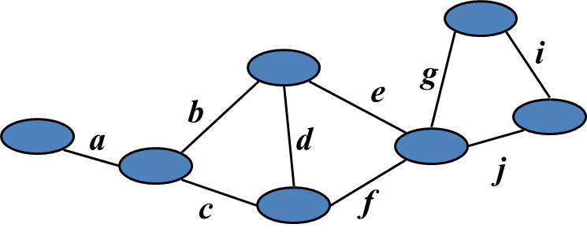
Link Relation
Edges e and f of connected graph G are linked if
e = f, or
G has a simple cycle containing e and f
Theorems:
The link relation on the edges of a graph is an equivalence relation
A biconnected component of G is the subgraph induced by an equivalence class of linked edges.
Equivalence classes of linked edges:
{a} {b, c, d, e, f} {g, i, j}

Slide 24
Link Components
The link components of a connected graph G are the equivalence classes of edges with respect to the link relation
A biconnected component of G is the subgraph of G induced by an equivalence class of linked edges
A separation edge is a single-element equivalence class of linked edges
A separation vertex has incident edges in at least two distinct equivalence classes of linked edge
ORD
PVD
SFO
LGA
RDU
HNL
LAX
DFW
MIA

Slide 25
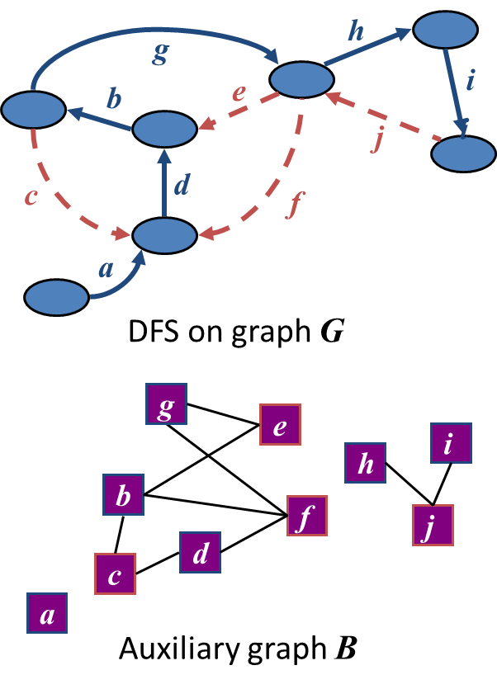
Auxiliary Graph
Auxiliary graph B for a connected graph G
Associated with a DFS traversal of G
The vertices of B are the edges of G
For each back edge e of G, B has edges (e,f₁), (e,f₂) , …, (e,f_{k}), where f₁, f₂, …, f_{k} are the discovery edges of G that form a simple cycle with e
Its connected components correspond to the link components of G

Slide 26
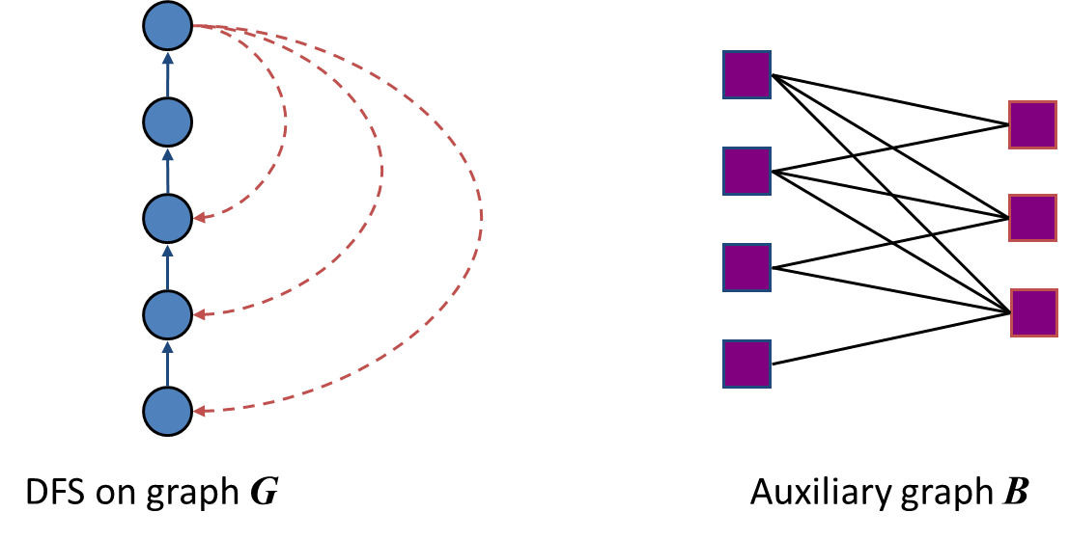
Auxiliary Graph (cont.)
In the worst case, the number of edges of the auxiliary graph is proportional to nm

